Slide 1
Android Dev : Kotlin
Insights
Krishna Rana
Ex-Android Intern @VECROS

Slide 2
What ?

Slide 4
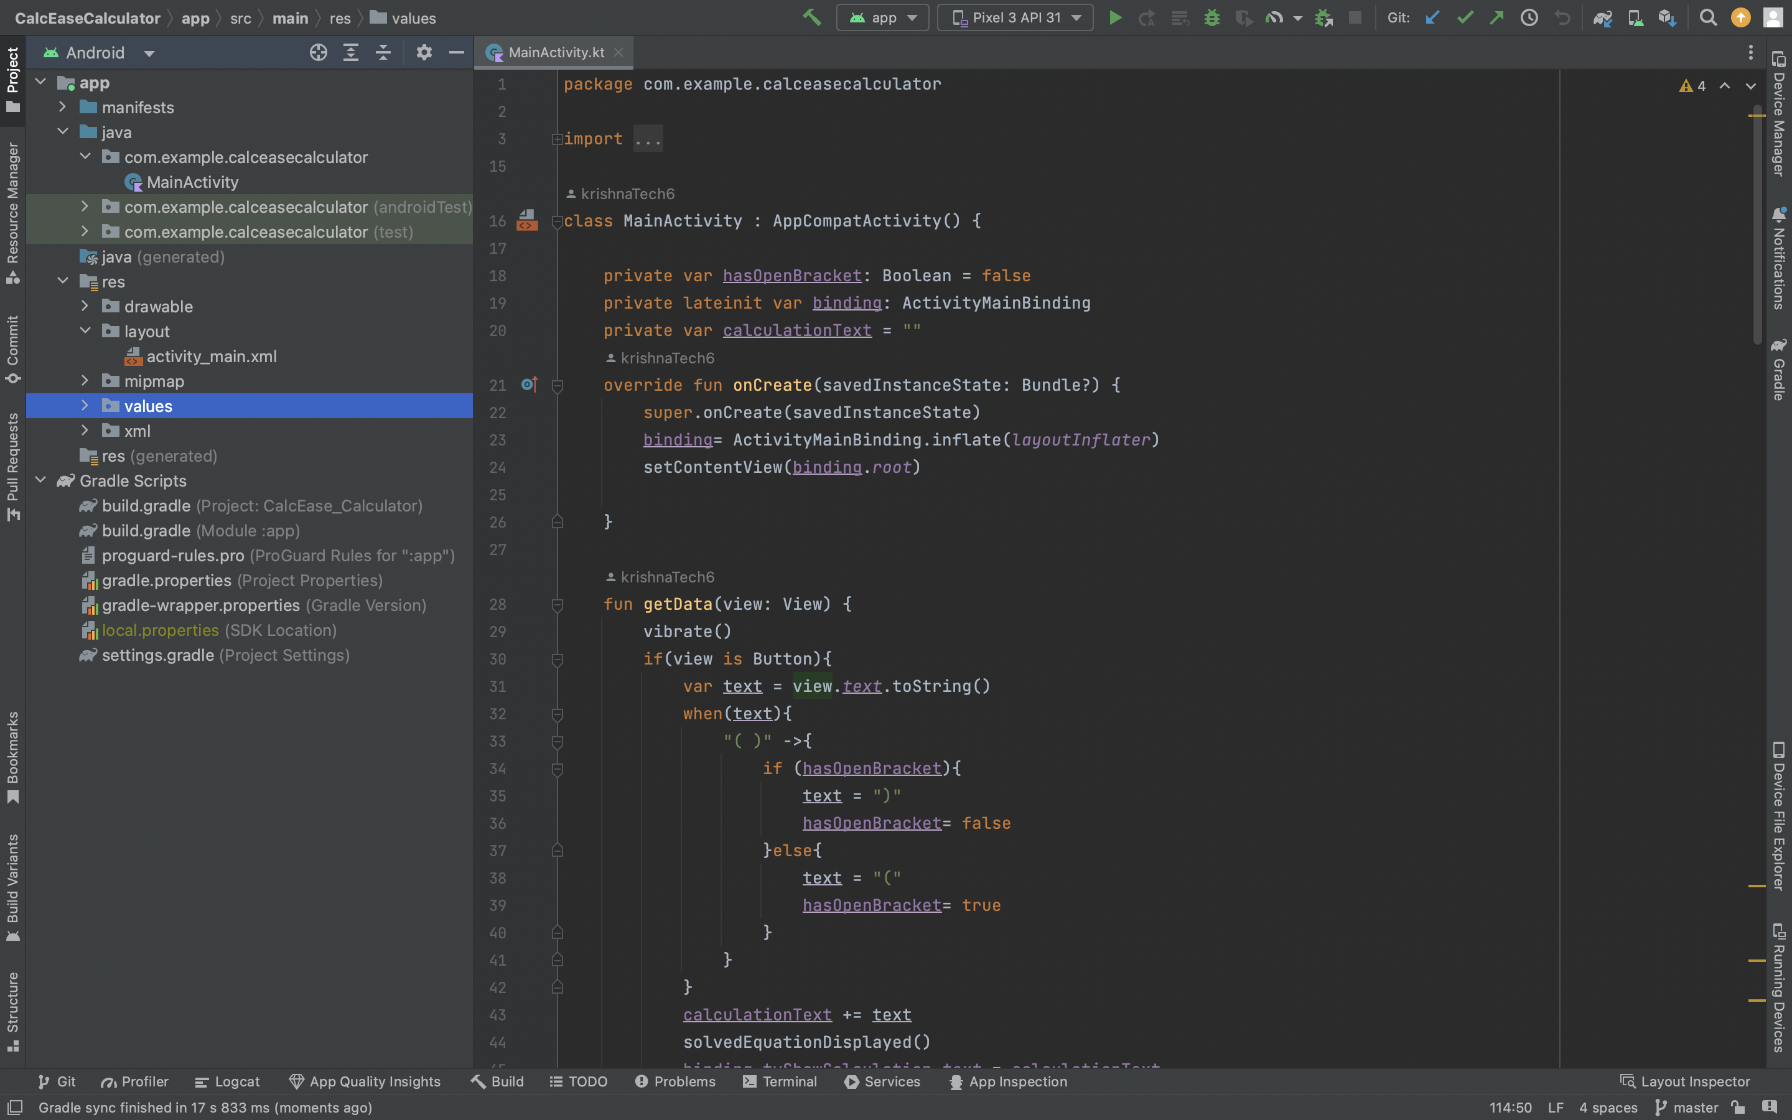

Slide 5
Why to choose ?

Slide 6
React Native
Flutter
Kotlin or Java
Technologies used :

Slide 7
Kotlin
Concise Syntax (Less Boilerplate code)
Modern Language
Null safety

Slide 8
How to start?
Start from kotlin or Java (Learn the basics of the language) 1-2 weeks
Intro to android studio and make some basic apps (2-3 days)
Calculator app
Image Gallery
Other app more focussed on Frontend and simple concepts

Slide 9
How to start?
Learn popular libraries - Glide , exoplayer , Retrofit, groovy, etc.
RoomDb, Firebase, Coroutines
Projects (try to do different)
Participate in group projects / open source contributions

Slide 10
Want to become a better Developer??
Be curious
Learn to learn from docs
Maintain Notion page
Learn about a topic and explore it
Chatgpt is your best friend

Slide 11
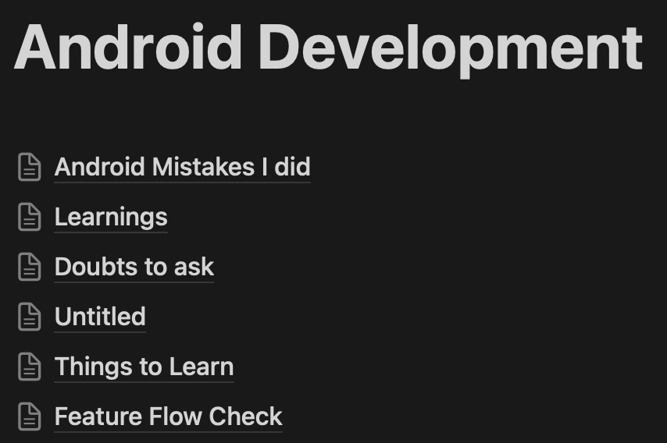
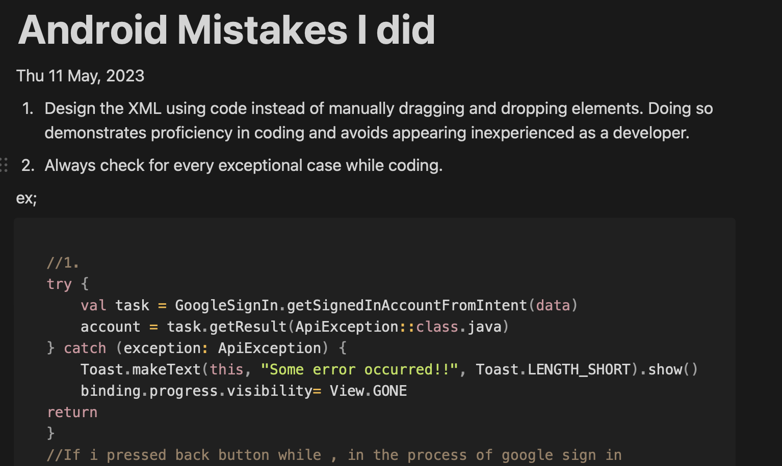
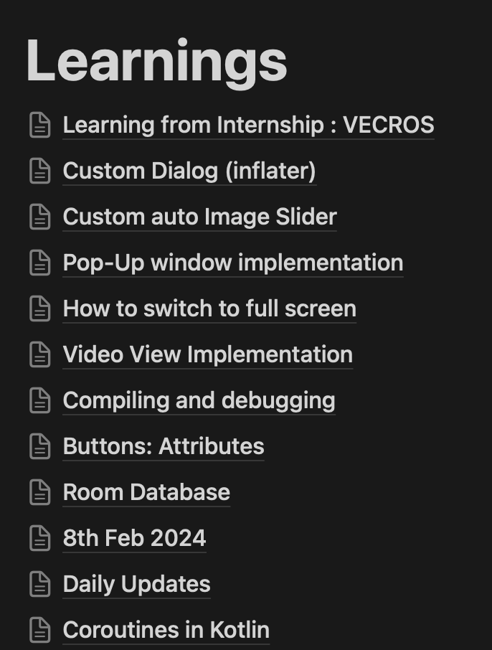

Slide 12
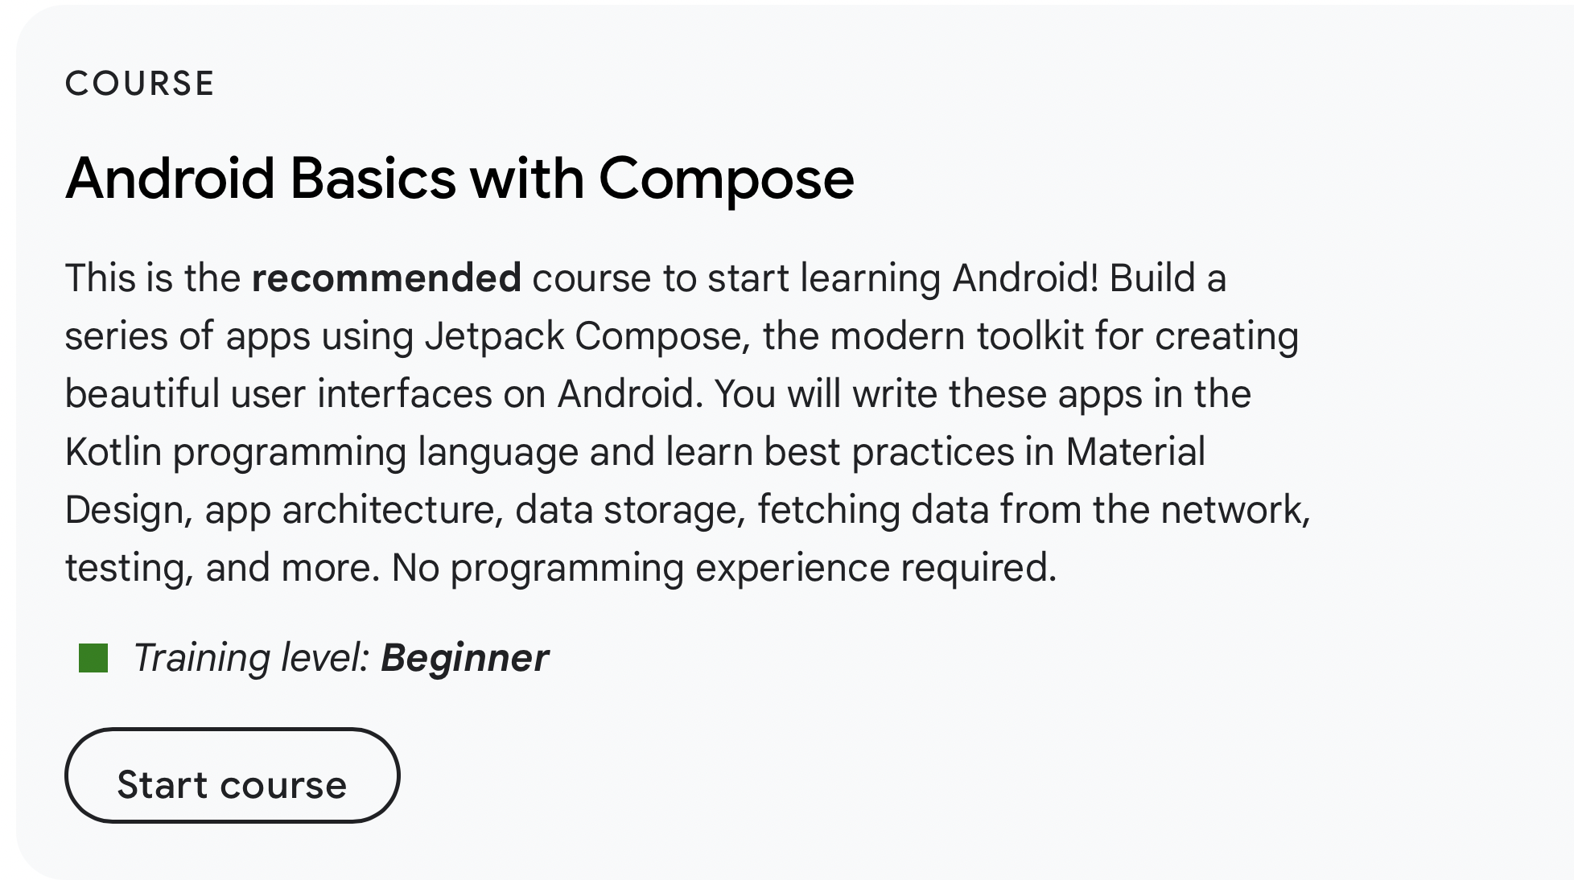
https://developer.android.com/courses

Slide 13
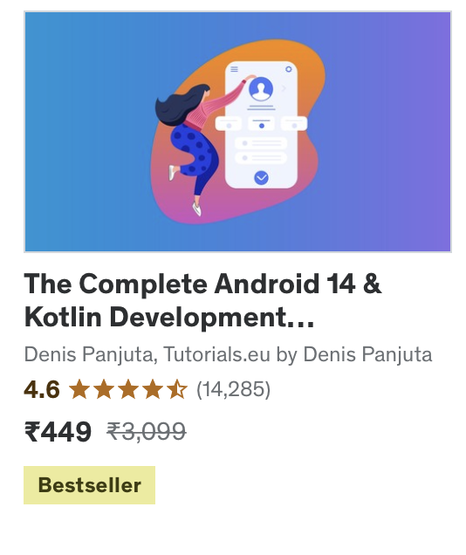
Courses I followed

Slide 14
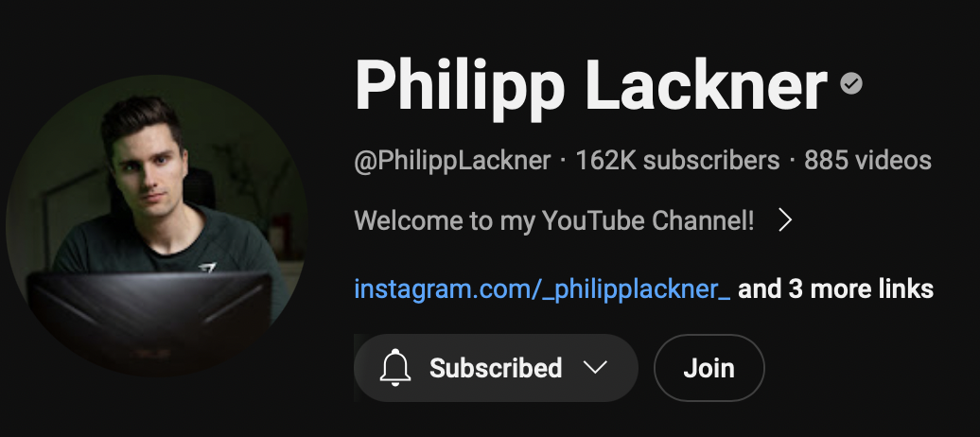
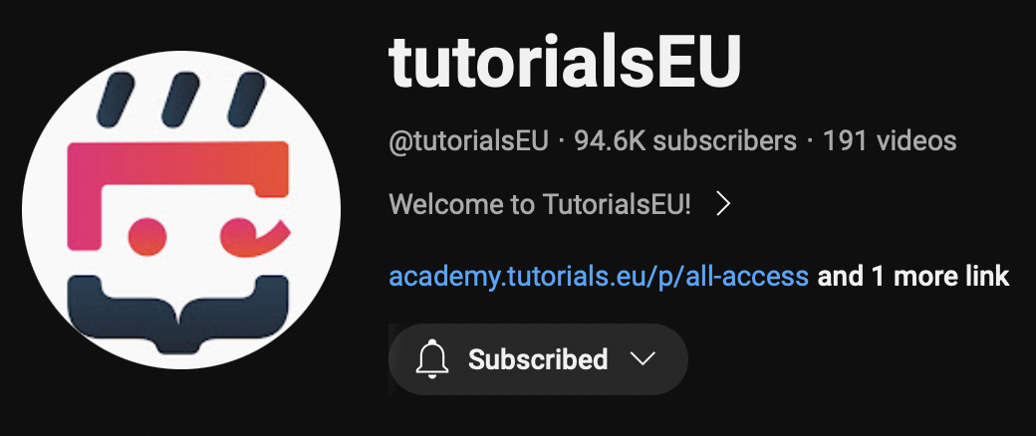
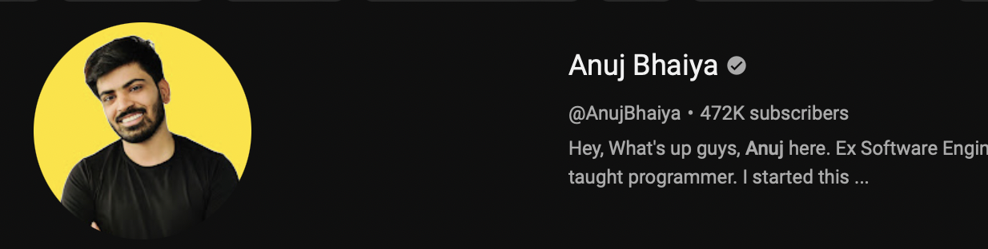
Channels to Follow
For compose -
Philipp Lackner (Compose)
Kotlin with XML
Denis Penjuta (TutorialsEU)
Anuj Bhaiya

